Slide 1
Computer Architecture Lab Presentation
On
Snake And Ladders Game
Under Supervision of:
Ms. Charu Upadhyay
Assistant Professor(CEIT)
Presented by:
Shyam Bihari Kumar
CEIT 3rd Year(99695)

Slide 2
Contents
Introduction
Objectives
Purpose
Technology Used
Features
Scope
Advantage
Output

Slide 3
Introduction
Snakes and Ladders Game is a classic board game that has been enjoyed by people of all ages for generations.
It's a game of chance and strategy, where players navigate through a gridded board filled with squares, each with a number.

Slide 4
Objectives
The Snakes and Ladders is simple yet challenging: be the first player to reach the highest-numbered square on the game board, typically labeled as 1001.
Game Development and Design:-Develop a functional and engaging digital version of the Snakes and Ladders board game.
2.Game Mechanics:-Implement accurate dice rolling mechanics to simulate the randomness of real-world dice rolls.

Slide 5
3.Multiplayer Functionality:- Include multiplayer capabilities to allow multiple players to play the game together either on the same device or online.
4.AI Opponent :- If desired, develop an AI opponent that players can compete against when playing solo.
5.Educational Aspect:- Create a platform for learning by incorporating features that enhance counting skills and understanding of probability for younger players.
6.Customization Options:-Include options for players to customize game settings, such as the number of players, and visual themes.

Slide 6
7. User Experience:-Ensure a smooth and enjoyable user experience by optimizing performance, and overall gameplay flow.
8.Documentation and Instructions:-Provide clear and concise instructions for how to play the game, including rules, controls, and any special features.
9.Cross-Platform Compatibility:-If applicable, ensure that the game is compatible with a range of devices and operating systems.

Slide 7
Purpose
The purpose of Snakes and Ladders game can encompass various goals and intentions, depending on the context and the stakeholders involved.
Entertainment and Recreation:
Education and Learning:
Accessibility and Convenience:
Project Showcase and Skill Demonstration:
Innovation and Creativity:
Social Interaction and Bonding:
Commercial Opportunity
Promotion of Digital Gaming Culture:

Slide 8
Technology Used
Snack and Ladders" seems like a playful twist on the classic game " If you're asking about the technology typically used in creating digital versions of the "Snakes and Ladders" game, here's a general overview:
1.Programming Language:-The game can be developed using various programming languages, with options such as HTML, CSS, PHP, JavaScript, and more.
2.Game Development Frameworks and Engines:- Game development engines like Unity or Unreal Engine are often used for creating interactive games

Slide 9
3.Graphics and UI Design:- Graphics design tools like Adobe Photoshop, Illustrator, or even open-source alternatives like GIMP can be used to create the game's visuals.
4.3D Modeling (Optional):- If you're creating a 3D version of the game, you might need 3D modeling software like Blender or Maya to create 3D assets.
5.Animation Tools:- Animation software like Adobe Animate, Spine, or Unity's animation system can be used to animate characters

Slide 10
7.Networking (Multiplayer):- If you're developing a multiplayer version of the game, networking libraries
8.Sound and Music:- Sound effects and background music can be created or sourced from libraries..
9.Version Control and Collaboration Tools:- Version control systems like Git and collaboration
10.Deployment and Distribution Platforms:- Once the game is ready, you'll need to choose where to release it.

Slide 11
Features
Certainly, here are some potential features that could be included in a digital "Snakes and Ladders" game project:
1.Game Modes:
2.Board Variations:
3.Graphics and Animations:
4.Player Customization:
5.Difficulty Levels:
6.Multiplayer Options:
7.Chat and Emotes:
8.Leaderboards and Achievements:
9.Tutorials and Help:

Slide 12
10.Sound Effects and Music
11.Settings and Options
13.Pause and Resume
14.Save and Load
15.Randomness and Fairness
16.Winning Conditions
17.Social Sharing
18.Ads and Monetization

Slide 13
Scope
The scope of a "Snakes and Ladders" digital game project can vary widely depending on factors such as the platform, target audience, development resources, and desired level of complexity. Here's an outline of the potential scope for such a project.
Snake & ladder board game develops counting abilities in children. The interesting part of this board game is not only its develop counting abilities, but also basic addition skills

Slide 14
Advantage
Creating a digital "Snakes and Ladders" game offers several advantages, both from a development and user perspective. Here are some of the key advantages:
1. Familiarity
2.Accessibility
3.Multiplayer Interaction
4.Dynamic Visuals and Animations
5.Customization and Variety
6.AI Opponents
7.Learning and Skill Development

Slide 15
Social Interaction
Scalability
Data Tracking and Analysis
Monetization Opportunities
Educational Value
Updates and Improvements
Integration with Online Platforms

Slide 16
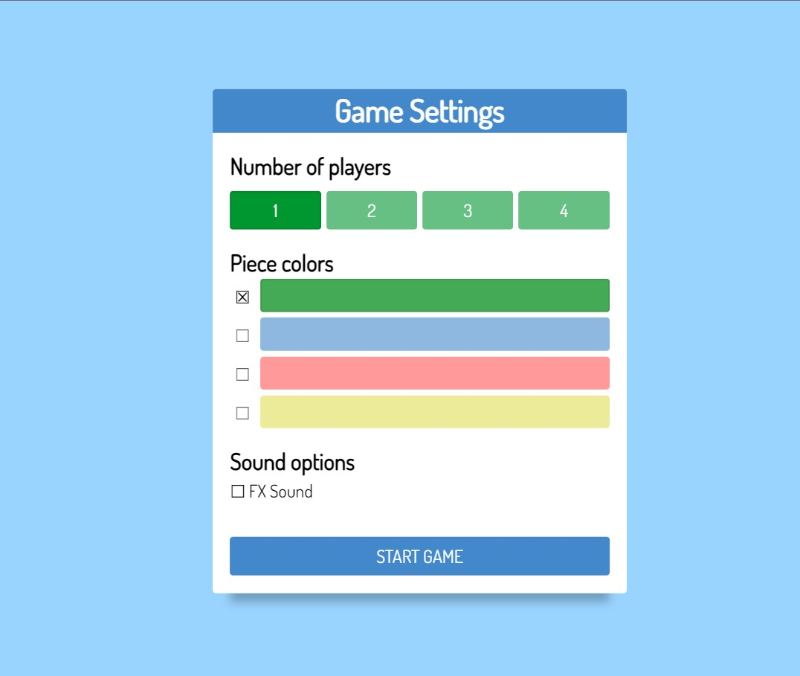
Output

Slide 17
Thank You

